Slide 1

CAPSTONE PROJECT
SUPERVISED LEARNING - CLASSIFICATION MODELING -GOOGLE PLAYSTORE

Slide 2
PROJECT AIM ( Research Topic):
The focus of this project will be to predict the ratings against the Playstore’s features.
To classify the ratings and categorical parameters to enhance customer experience.

Slide 3
Dataset Information
The Data was taken from Kaggle.com
The dataset that has been used in this project is the latest available Google Playstore data on the internet.
Contents: Ratings, Reviews, Price, Instrallation, Size, Content_Category, App Name, Last updated, Minimum Version and Latest Version
There are 11 columns and 32k Rows.

Slide 4
Exploratory Data Analysis (EDA) and Data Cleaning
There were variables with several unwanted elements present in the data such as “$” ,”+”, “,” “k”, etc.
The Category, Content_rating, were one hot encoded.
Numerical columns were checked for strings and removed the unwanted dirty data wherever applicable.

Slide 5
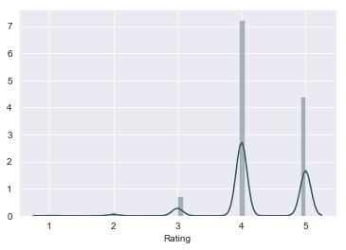
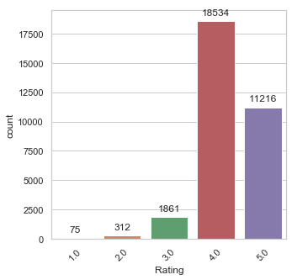
Visualization
The ratings are majorly concentrated from 4-5.

Slide 6
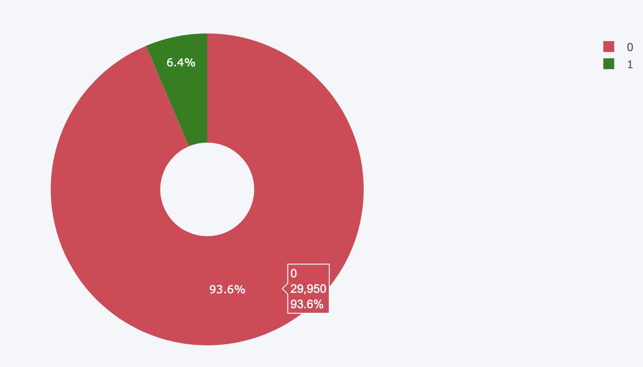
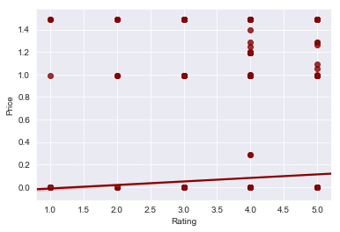
Paid vs Free
PAID VS FREE APPS
6.4% of the apps were paid.

Slide 7
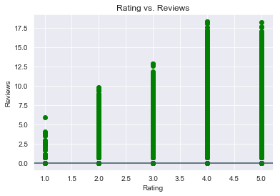
Ratings vs Reviews
The Rating increases as the review count increases.
The highest rating 5 has the highest number of reviews recorded in the data.

Slide 8
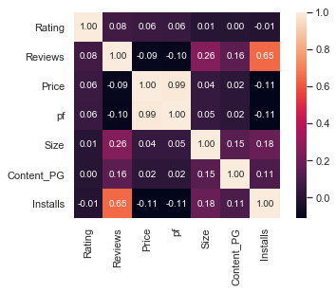
Correlation Map against Ratings
Reviews and Installs had the highest correlation.
The target was set as ratings, to get the top correlated variables:
Reviews
Price
Interaction of Review and Price

Slide 9
Feature Engineering
Feature Selection : Reveiws, Price, Installs, Size, Content_PG, Paid or Free, Category Code, Interaction between Price and Reviews.
Interaction of Price and Reviews
Interaction of Reviews and Installs
Ratings were binarized by splitting them to two parts, ratings below 4 and ratings above 4.

Slide 10
Classification Modeling
Train,Test,Split:
X = google_df.drop(‘Rating’,1)
y = google_df.Rating
X_train, X_test, y_train, y_test = train_test_split(google_df.drop('Rating', 1),google_df.Rating, test_size = 0.30)

Slide 11
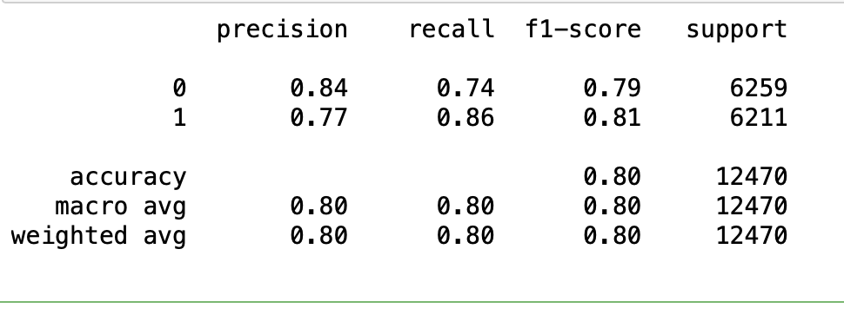
Random Forest Classifier

Slide 12
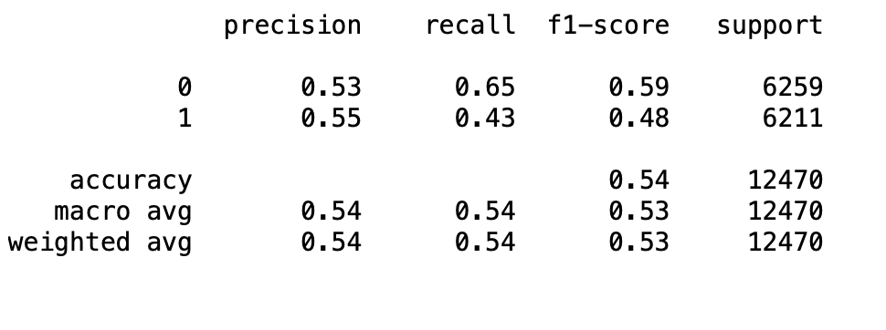
Logistic Regression Classifier

Slide 13
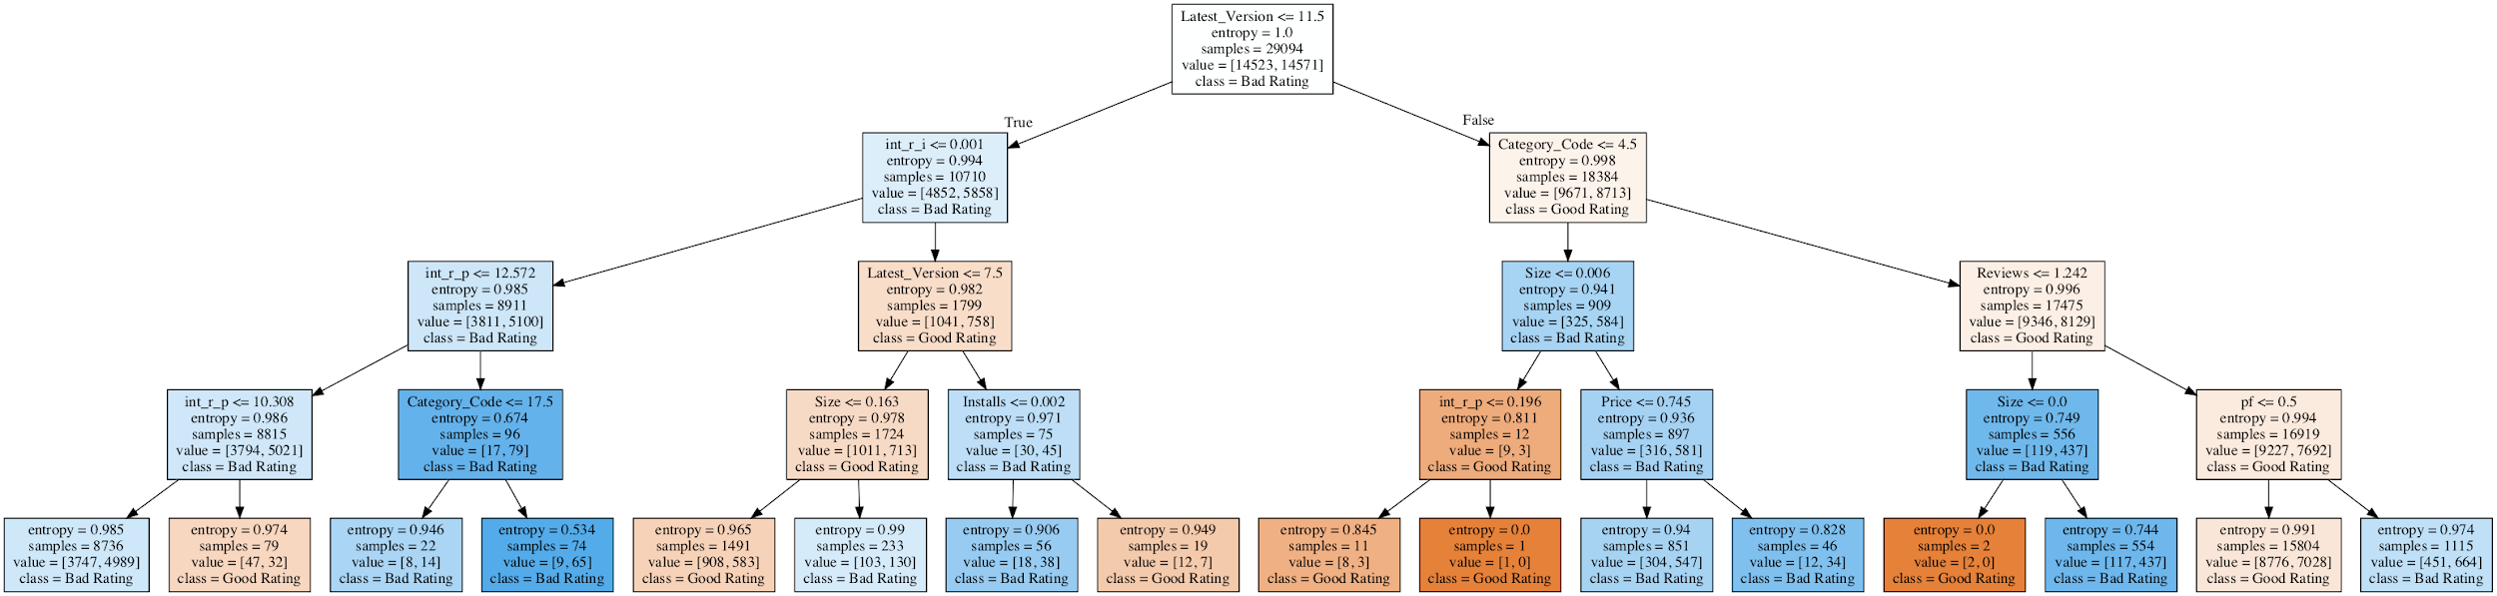
Decision Tree

Slide 14
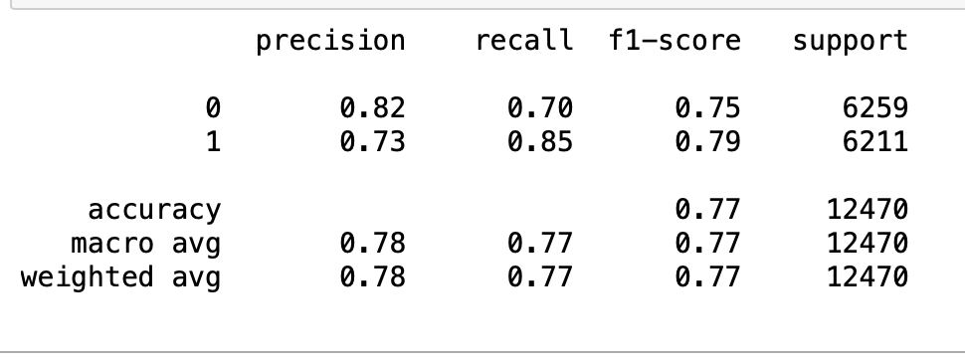
Decision Tree Classifier

Slide 15
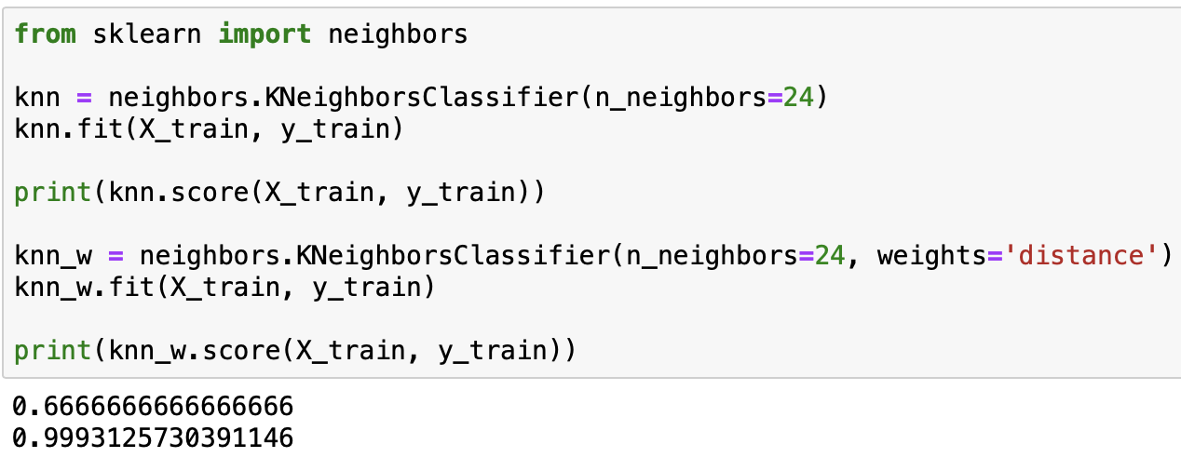
KNN Classifier

Slide 16
Challenges:
The Ratings were majorly concentrated from 4 to 5.
This created a class imbalance while training the model.
The imbalance was treated by upsampling using sklearn’s resample.
The data were really messy and had a lot of strings which called in for longer data cleaning process.

Slide 17
CONCLUSION
The model works much better after binazring the target variable “Rating”.
The Random Forest classifier had the highest predicting accuracy with 84%.
The bias is high due to the fact that we are predicting one feature with 8+ dimension..

